Slide 1
  Waiting lists in Healthcare
  Task 8.4:
  COVID-19 related international guidelines, initiatives, projects and information sources
  – Róbert Láng (HU)
REF meeting
13th February, 2023

Slide 2
Waiting Times for Health Services – OECD May 28, 2020
Long waiting times for health services have been an important policy issue in most OECD countries for many years. Governments in many countries have taken various measures over the past two decades to reduce waiting times, often supported by additional funding, with mixed success.
Waiting times for elective treatment stalled between 2010 and 2019 in many countries, and had started to rise in some countries even before the COVID-19 pandemic. The COVID-19 outbreak resulted in at least some temporary increases in waiting times for non-urgent services in all the OECD countries that have been hard hit.

Slide 3
Waiting Times for Health Services – OECD May 28, 2020
In normal circumstances, waiting times and waiting lists generally arise as the result of an imbalance between the demand for and the supply of health services.
Some waiting times can improve the efficiency in the utilisation of resources by reducing idle capacity.
Waiting times for health services in publicly-funded systems aim to create equality between patients: patients with similar needs are supposed to wait their turn irrespective of their ability to pay or other non-clinical characteristics.
Several studies have found inequalities in waiting times by income or educational level even in publicly-funded health systems.
The wait may worsen the health outcomes for patients. The available evidence shows that the effect on health outcomes depends on the duration of the wait, the health problem and the clinical prioritisation.

Slide 4
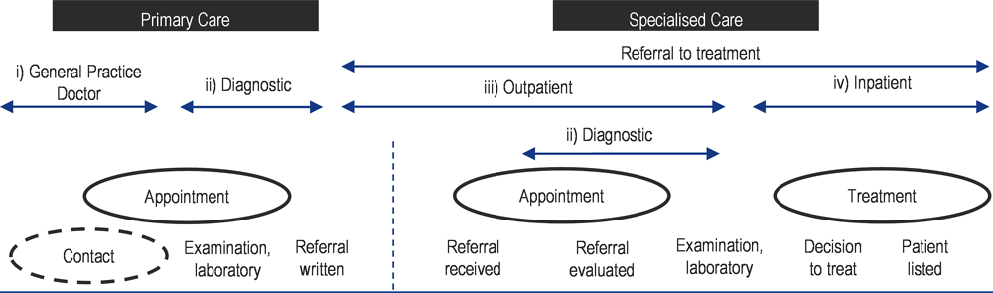
Possible waiting times
Source: Adapted from Siciliani, Borowitz and Moran (2013[1]), Waiting Time Policies in the Health Sector: What Works?, OECD Health Policy Studies, https://dx.doi.org/10.1787/9789264179080-en.

Slide 5
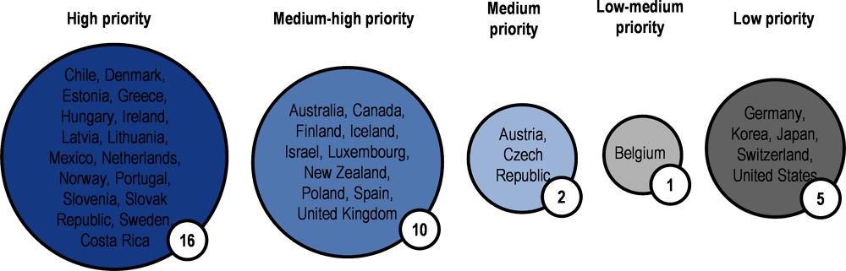
Waiting times are an important policy priority in many OECD countries, but not all
Source: Based on responses from 34 countries to the OECD Waiting Times Policy Questionnaire (information is missing from three countries: France, Italy and Turkey).

Slide 6
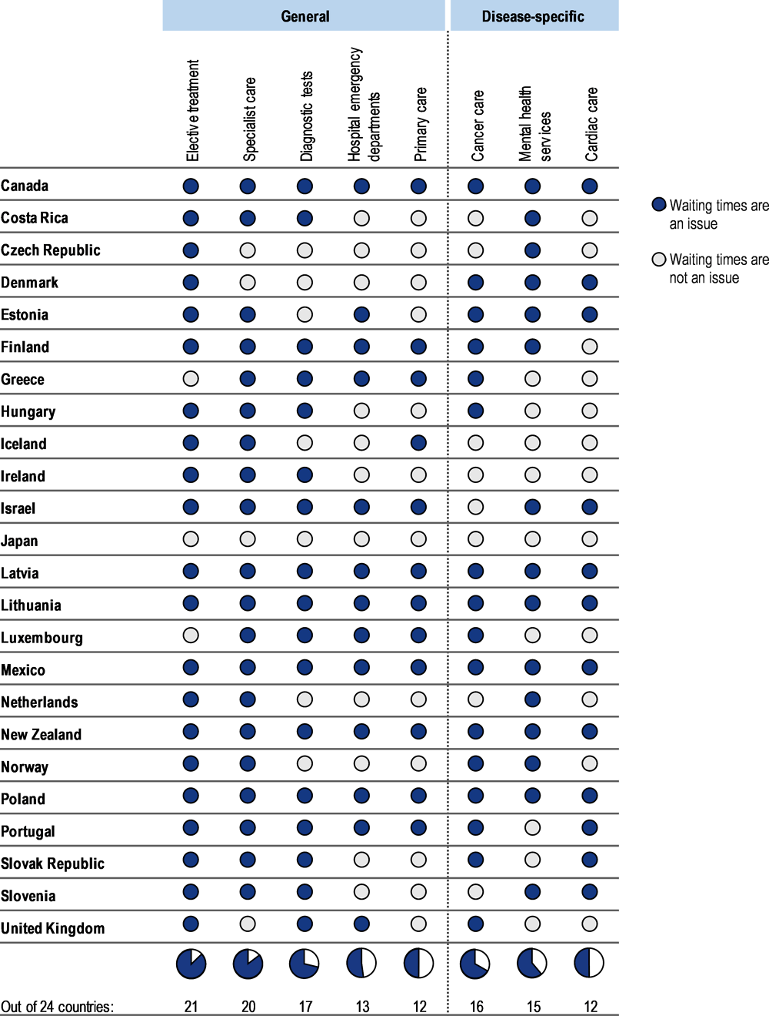
Waiting times are considered to be an issue across different types of health services

Slide 7
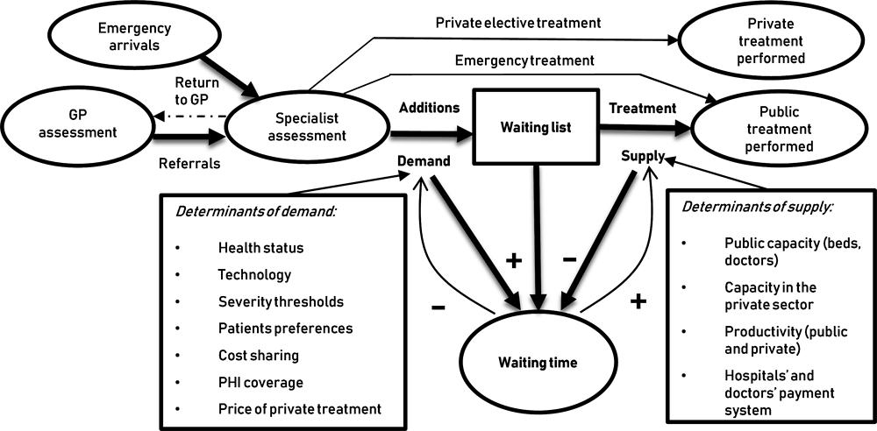
Conceptual framework to analyse waiting lists and waiting times for elective care

Slide 8
Dynamic phenomenon
Waiting times are a dynamic phenomenon. They increase over time if demand exceeds the supply, and reduce if supply exceeds demand. Both demand and supply are likely to grow over time.
Demand increases over time because of population ageing, which increases needs, or through technological development, which increases the range of conditions that are treatable.
Supply may also increase over time due to technological development, which for example allows patients to be treated as day cases in hospitals, possibly allowing a larger number of patients to be treated over a given week or month.
This dynamic element implies that periods of increasing supply can be associated with increasing waiting times if demand grows at a faster rate.

Slide 9
Policies to reduce waiting times
The right policy mix for each country is likely to depend on the health system.
However, successful approaches typically combine the specification of an appropriate maximum waiting time together with
supply-side (increase resources (human and/or technical) and productivity) and
demand-side interventions and
a regular monitoring of progress.

Slide 10
Addressing backlogs and managing waiting lists during and beyond the COVID-19 pandemic – WHO Policy Brief 47, July 6, 2022
COVID-19 meant non-emergency procedures were postponed which led to backlogs of care (and particularly hospital and specialist care) in virtually all countries. These jeopardize health outcomes.
Countries still struggle to understand the extent of backlogs but they are testing policies in practice and are generating lessons on what works.
Drivers that increase the backlog include:
  - Supply-side factors, such as: low numbers of health workers (even pre-COVID); lower productivity due to staff exhaustion; the extra cost of providing treatment safely; and weakened incentives for some care.
  - Demand-side factors include: new technologies; the ageing of the population and the rise of chronic conditions (including long COVID).
Drivers that decrease the backlog include:
  - Supply-side factors, such as: sufficient workforce and infrastructure; extra funding; and more efficient new technologies and digital solutions.
  - On the demand side, fear of infection may reduce demand, although this may also increase unmet need.

Slide 11
Three broad groups of overlapping strategies
Restoring care to previous levels is not enough to overcome the backlogs but three broad groups of (overlapping) strategies are helping:
  Increasing workforce and staffing with new professional roles and competencies; flexible recruitment and training; and improved work conditions and compensation.
  Improving productivity, management of capacity and demand, separating planned and unplanned care; introducing tailored financial incentives; expanding access to telehealth; careful prioritization; and spreading patients to fit available capacity.
  Investing in capital, infrastructure and new models of care, for example, by upgrading health facilities or digital infrastructure; investing in primary and community care; or expanding home care.

Slide 12
Reduce risks
Policy-makers can reduce the risks associated with these strategies by:
  Pairing improvements in workforce planning and availability with policies to support and protect health workers.
  Monitoring policies to rationalize health care delivery, reduce waste or use digital solutions to ensure they do not (inadvertently) increase inequalities in utilization and health.

Slide 13
Important challenges remain
Clearing care backlogs as quickly as possible will be critical for maintaining health gains achieved before the pandemic and avoiding increasing excess mortality.
It is still uncertain how much capacity will be needed to care for COVID-19 patients, how much is needed to reduce the backlog, and how many ‘missing patients’ with unmet needs there are. Furthermore, many of the policies that can reduce backlogs are demanding on an already overstretched workforce.
This places increasing pressure on health workers, putting them at increased risk of absenteeism and burnout.
Therefore, policies to support and protect health workers should be prioritized alongside improving workforce planning and workforce availability, both of which remain inadequate in many countries.
In this process, it is important that policies that further rationalize health care delivery (including by reducing waste and inappropriate care, and making increased use of digital solutions), do not increase inequalities in utilization and health.

